Slide 1
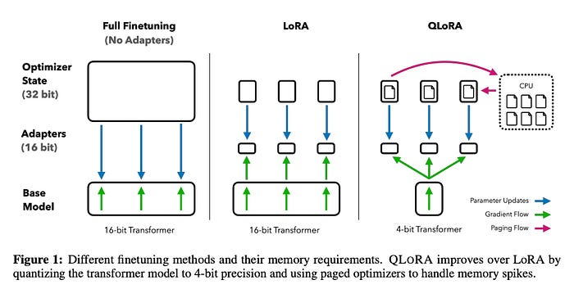
Model Shrinking: The Power of 4-bit Quantization
Quantization reduces the precision of model weights (e.g., from 16-bit floats to 4-bit integers).
GGUF & EXL2: Specialized formats that allow giant models (like a 70B parameter Llama) to run on consumer laptops by drastically reducing VRAM usage.
This process "shrinks" the model size by 70-80% with only a minimal hit to intelligence.

Slide 2
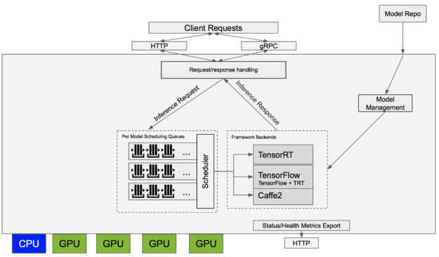
Industrial Inference: ONNX & TensorRT
ONNX (Open Neural Network Exchange): A universal format that allows a model trained in PyTorch to run on any hardware or framework.
TensorRT: NVIDIA’s optimization engine that compiles models to run at maximum speed on specific GPUs.
These tools are essential for "Production AI" where response time (latency) must be in milliseconds.

Slide 3
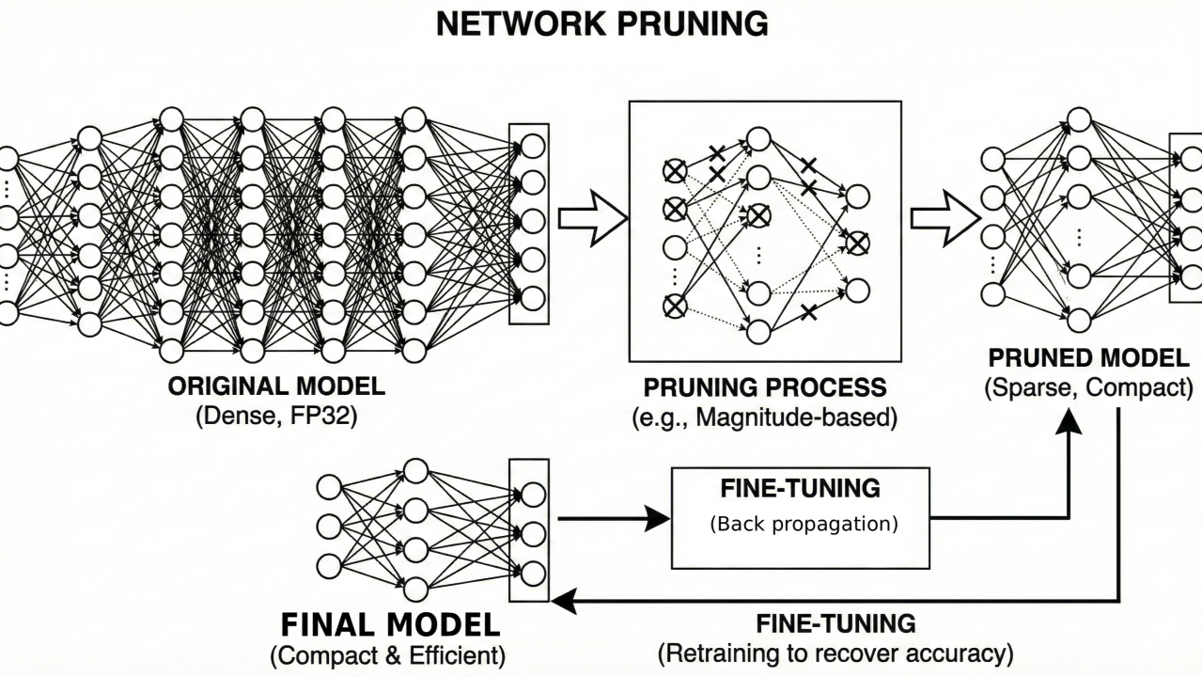
Pruning: Trimming the Fat
Pruning involves identifying and removing "useless" neurons or connections that contribute little to the final output.
By zeroing out these weights, we make the model "sparse" and much lighter.
Combined with quantization, pruning allows complex AI to run on "Edge" devices like smartphones and IoT sensors.

